Slide 1



Reverse engineering 101

Slide 2

What is reverse engineering
The analysis of a device or program to determine its function or structure, often with the intent of re-creating or modifying it.

Slide 3

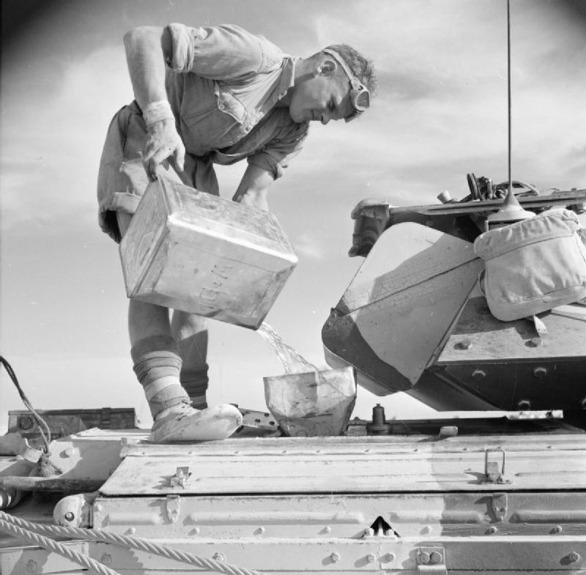
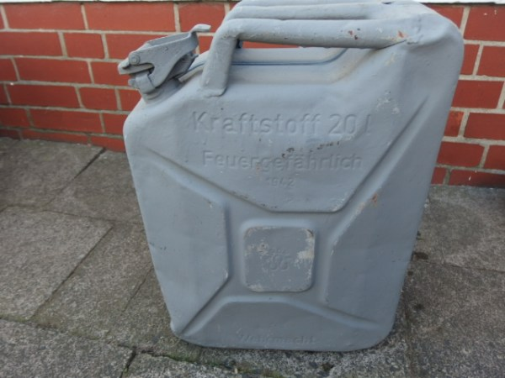
History 101
German
American
British
Notes:
Vinzenz Grünvogel
Paul Pleiss
1939

Slide 4
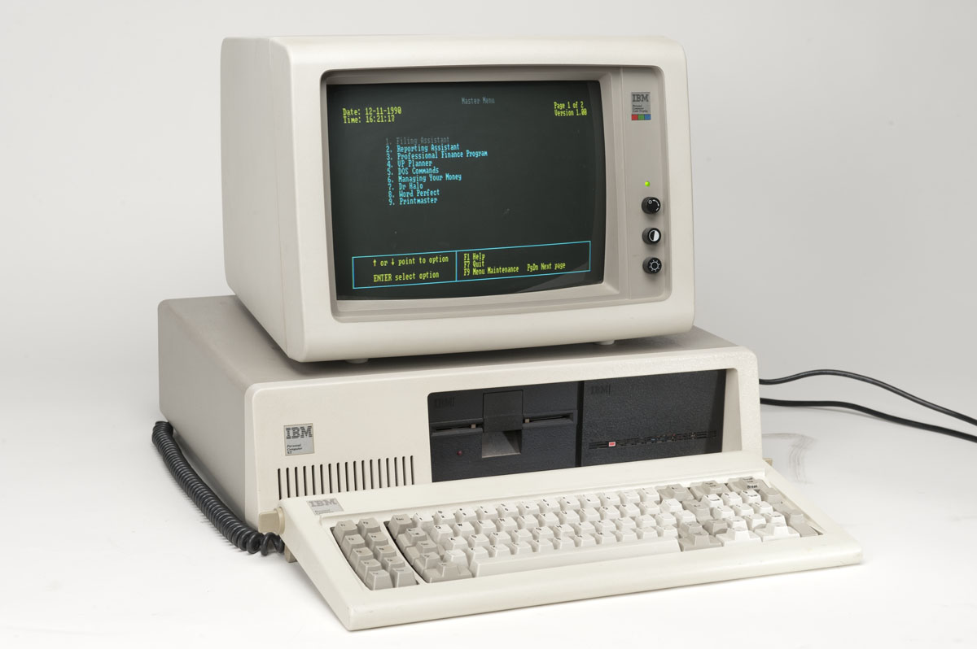


History 101
1982
1990
Notes:
Historic IBM PC compatible industry that has been the overwhelmingly-dominant computer hardware platform for many years
Apple II, TRS-80, and Commodore 64
the process of analyzing a subject system to identify the system's components and their interrelationships and to create representations of the system in another form or at a higher level of abstraction" in which the "subject system”
Institute of Electrical and Electronics Engineers
JAD/LibreOffice

Slide 5
Why do re
Security auditing
Removal of copy protection ("cracking")
Circumvention of access restrictions often present in consumer electronics,
Customization of embedded systems such as engine management systems
In-house repairs or retrofits
Enabling of additional features on low-cost "crippled" hardware such as some graphics card chip-sets
Mere satisfaction of curiosity.

Slide 6
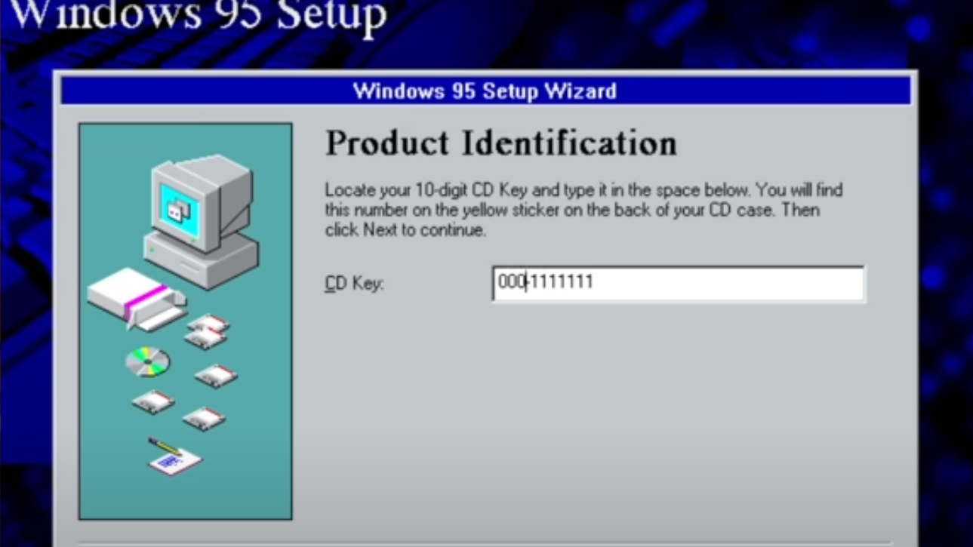
Example – Win 95
(src: https://www.youtube.com/watch?v=cwyH59nACzQ)

Slide 7
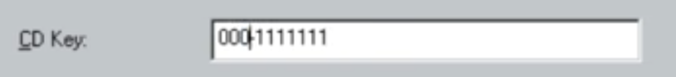
Valid CD Keys:
0000000
0000007
0000016
0000025
1111111
Invalid 3 digits:
111
222
Valid CD keys:
123
312
1+1+1+1+1+1 =7
x/7 = 1

Slide 8
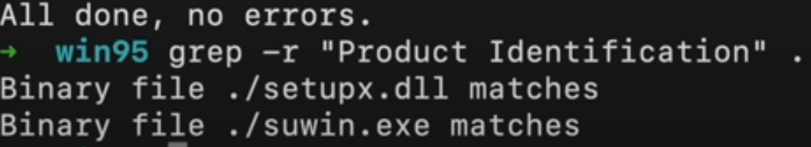
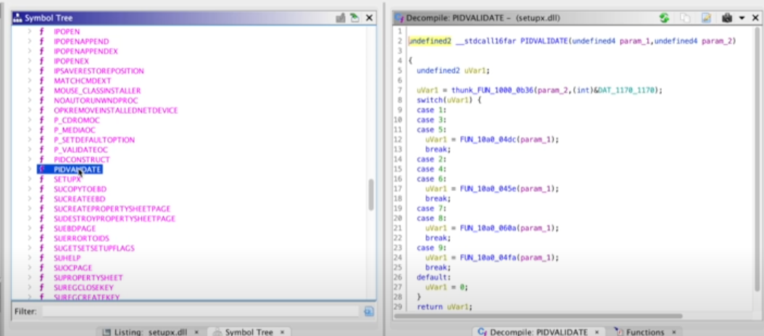

Slide 9
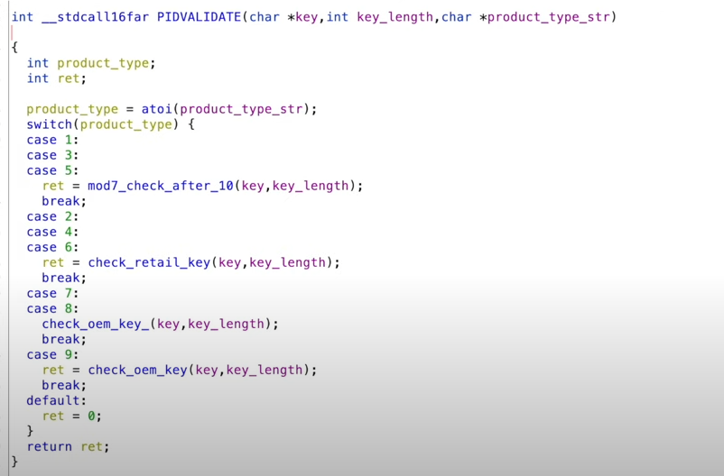
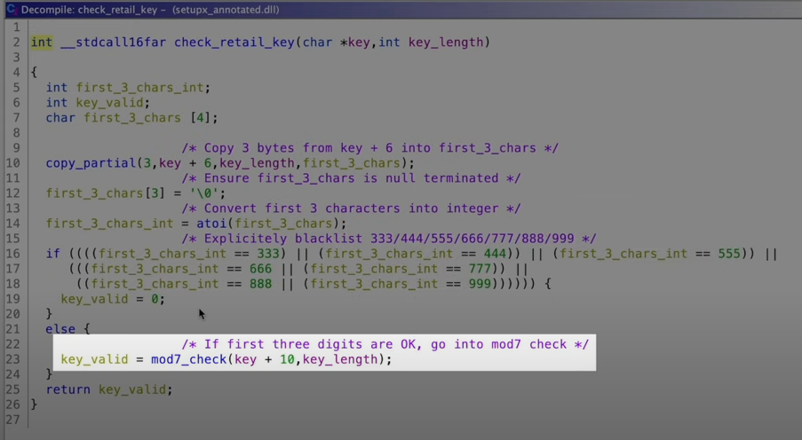
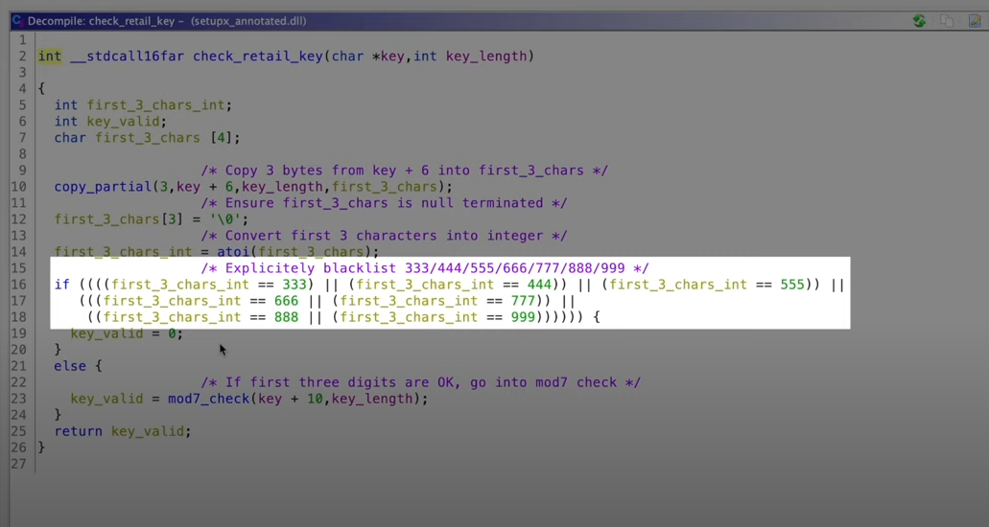

Slide 10

In practice

Slide 11
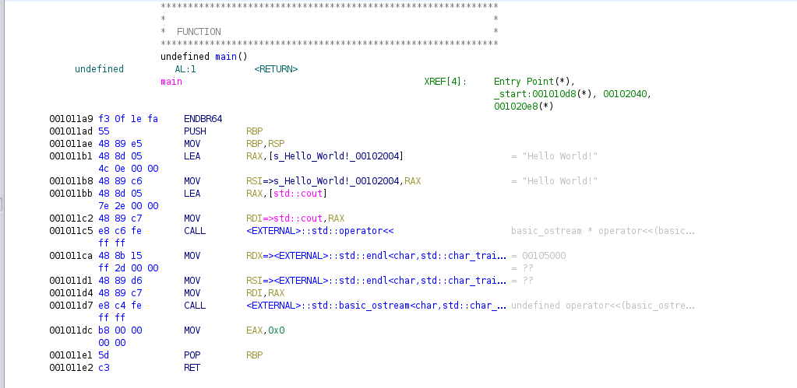
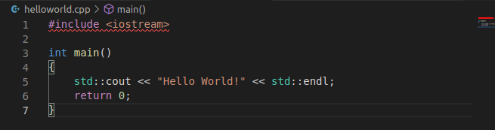

Slide 12
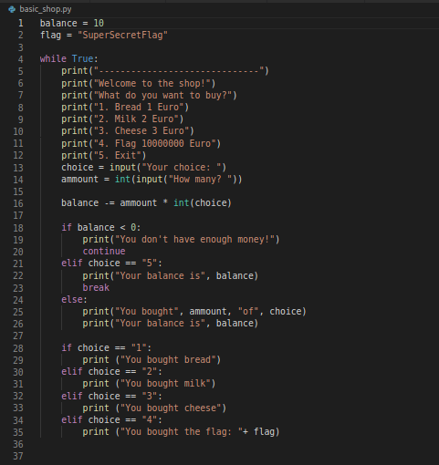
Exercise 1

Slide 13
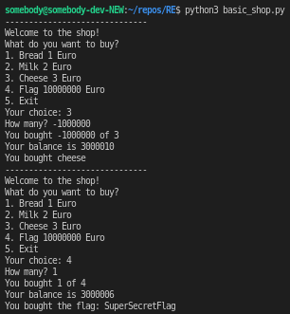
solution

Slide 14

Exercise 2

Slide 15
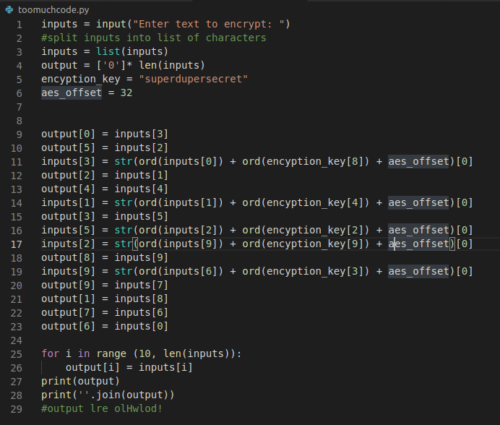
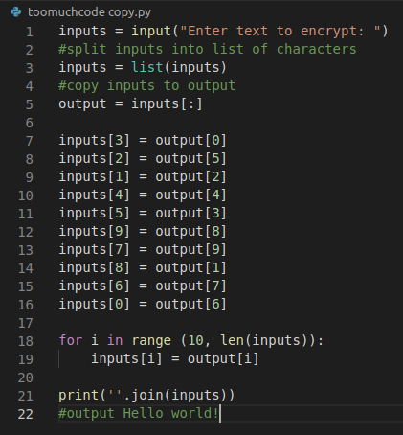



Slide 16
Exercise 3

Slide 17
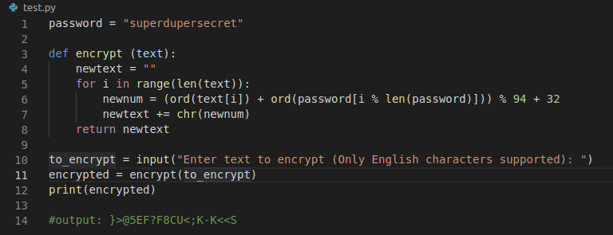

Slide 18
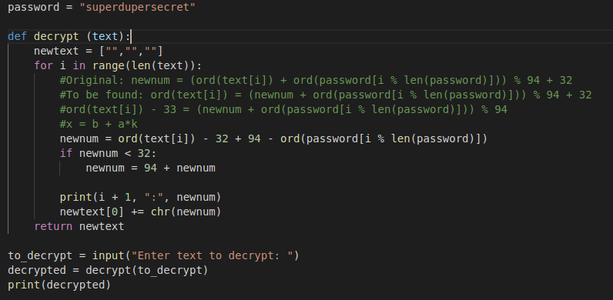

Slide 19
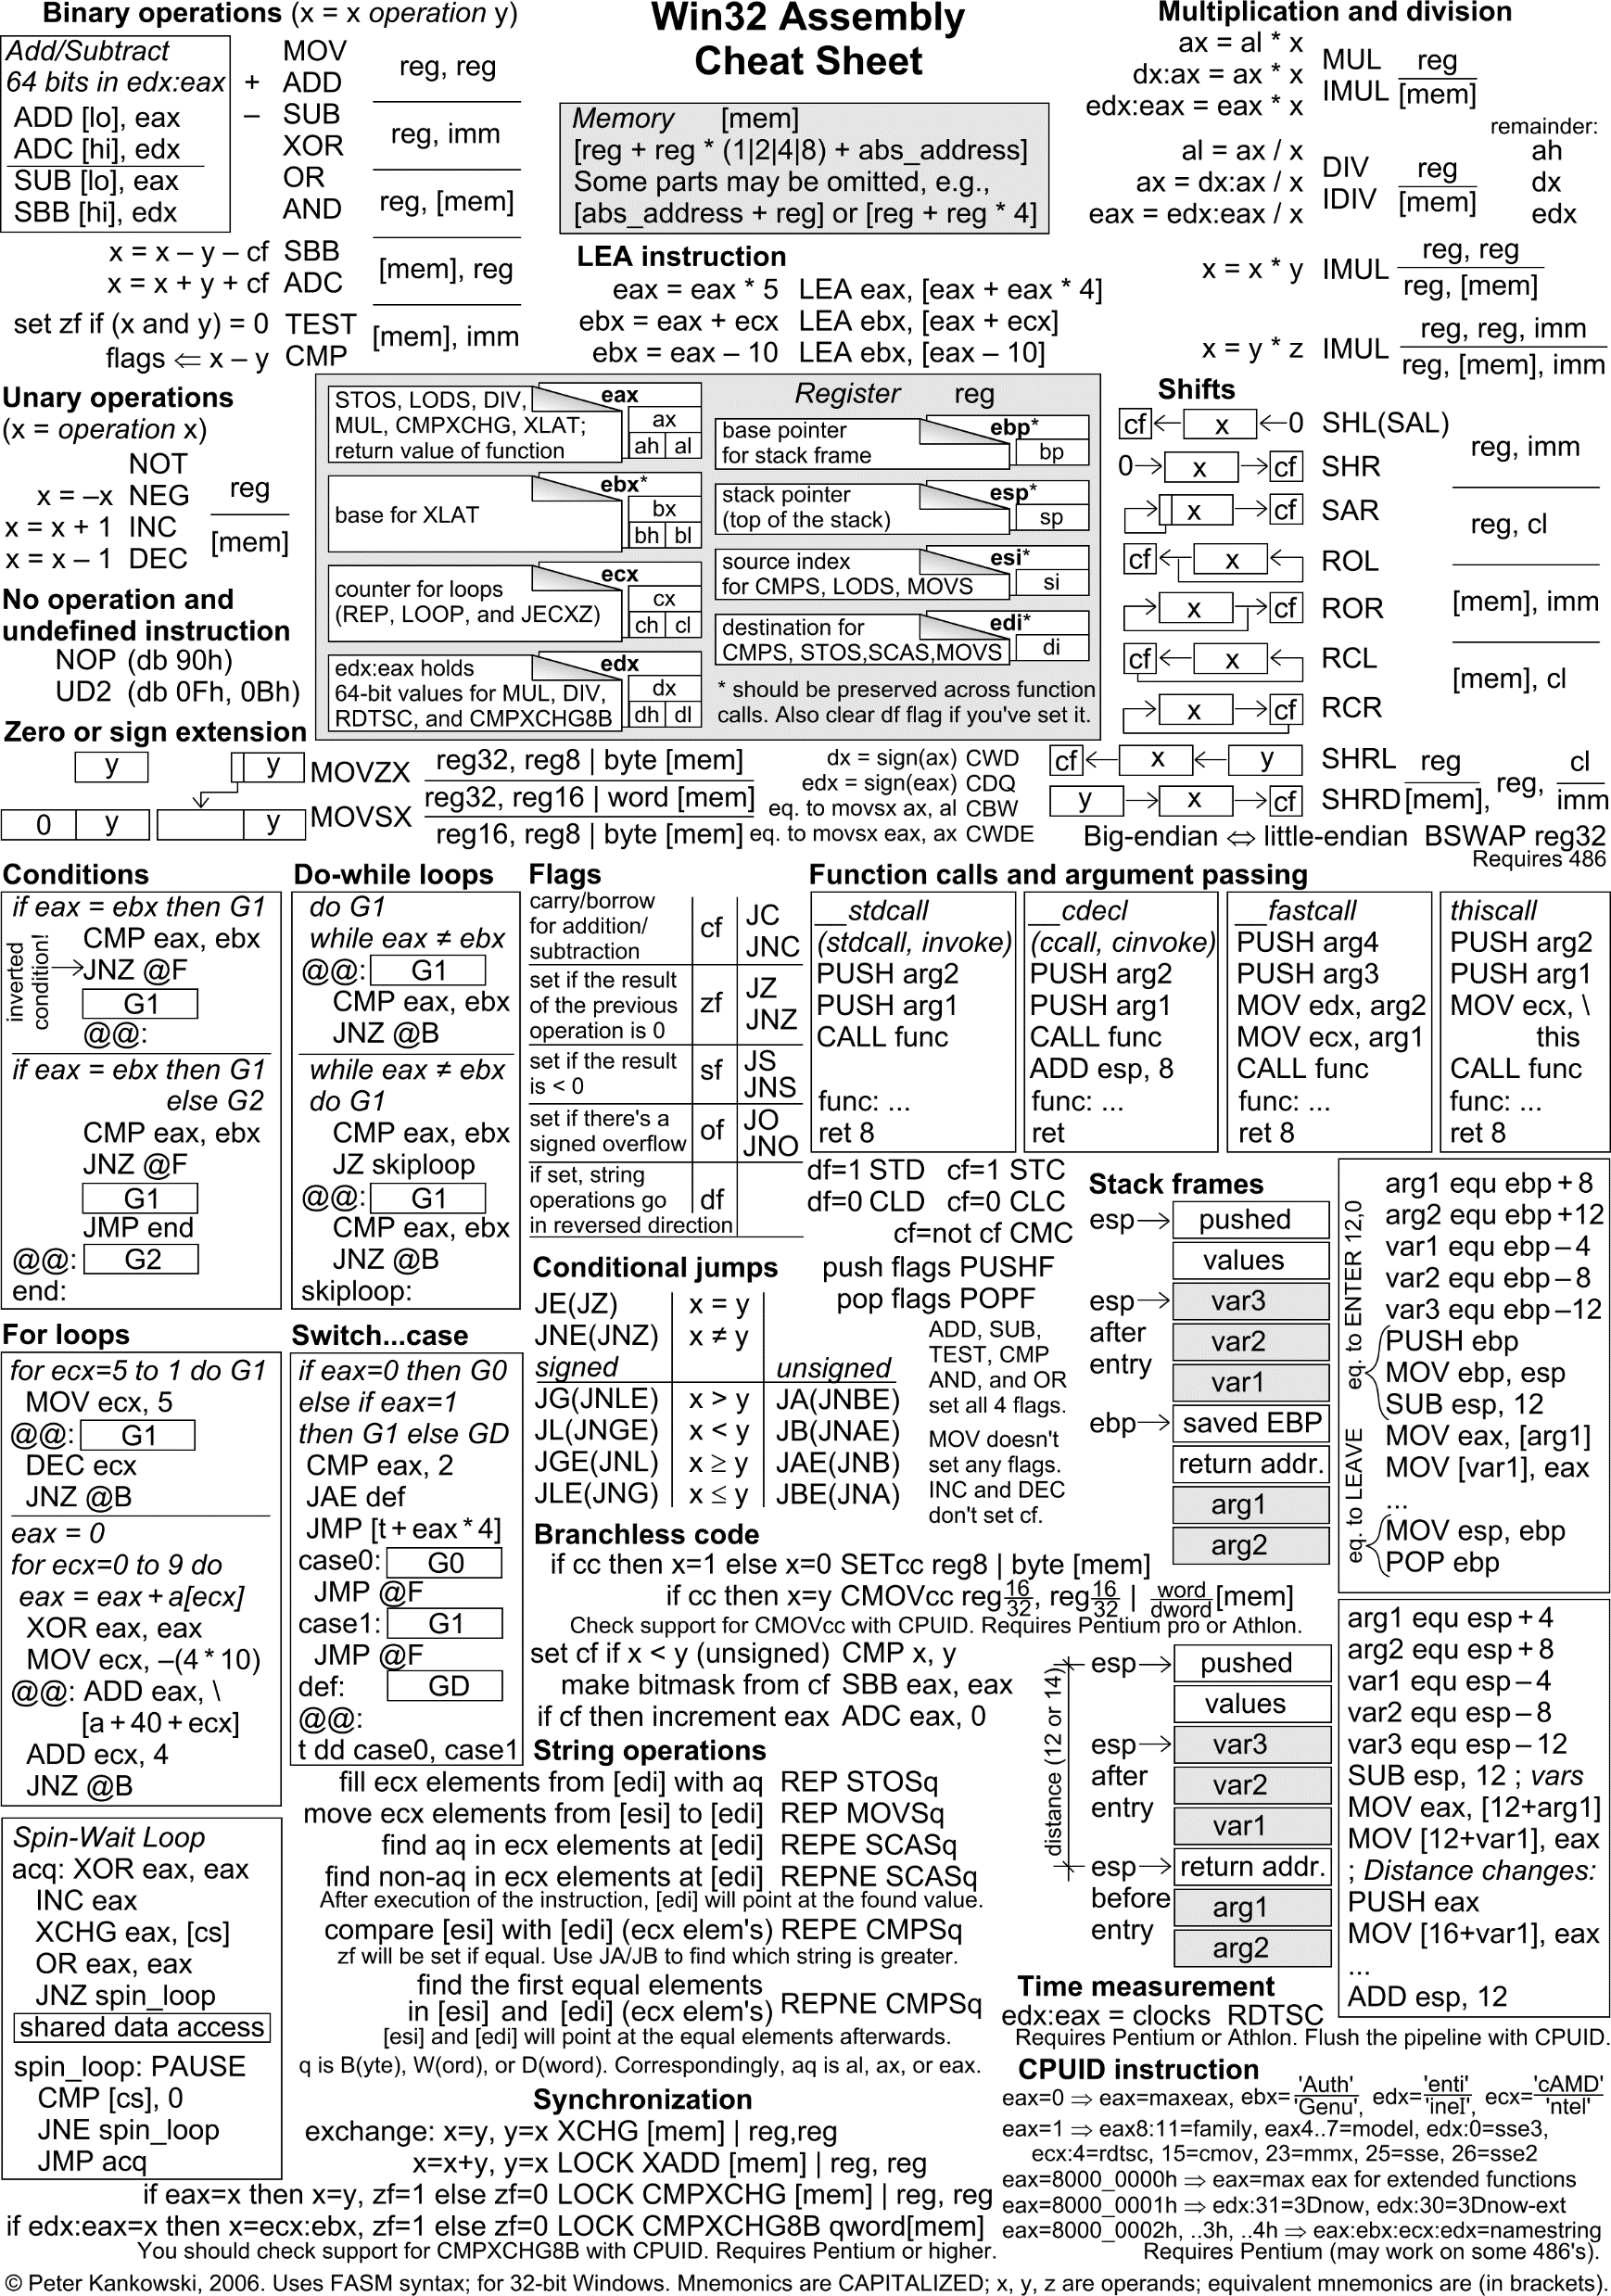
assembly
Read up on:
https://www.tutorialspoint.com/assembly_programming/index.htm
(Not today)

Slide 20
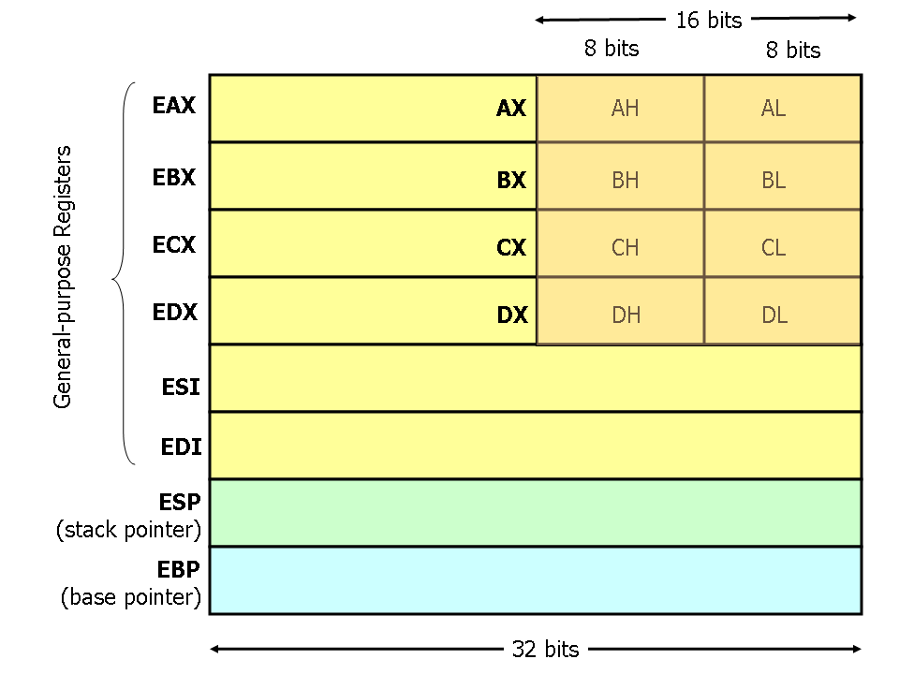
Memory & registers
Function arguments
Function return
Etc

Slide 21
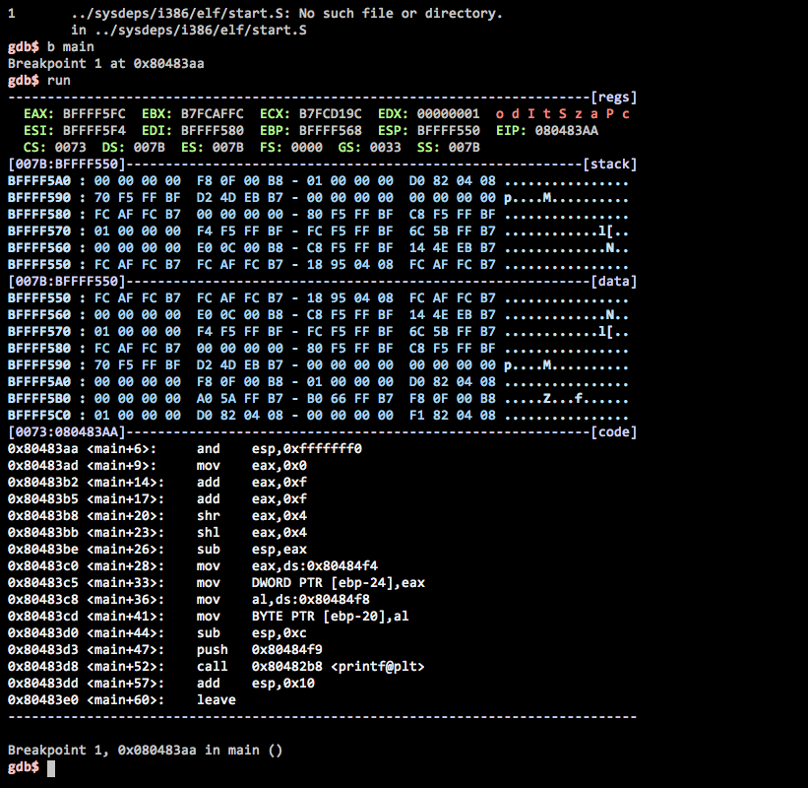
GDB

Slide 22
Building a Toolchain
General Decompilers: Ghidra, IDA (pro), BinaryNinja, objdump
Mobile decompiler: apktool,dex2jar,jd-GUI, MOB-SF
.NET: ILSpy, dotPEEK
Golang: gotools (ghidra)
Debuggers: radare2,gdb, cutter.

Slide 23


Introducing ghidra
Ghidra is a free and open source reverse engineering tool developed by the National Security Agency of the United States. The binaries were released at RSA Conference in March 2019; the sources were published one month later on GitHub.

Slide 24

Tech support time
Couldn’t get it installed? Speak up!
If done? Mess around!

Slide 26
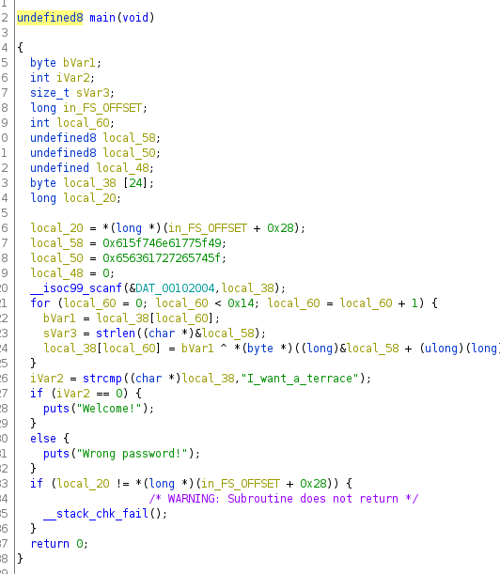
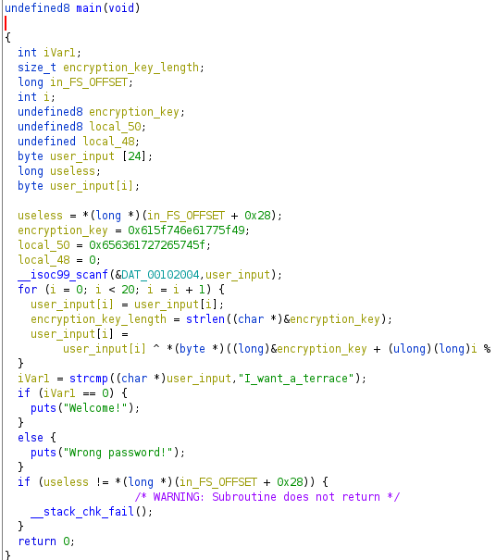
Good practices
Rename variables
Set types
Identify and rename functions
Mark useless ones

Slide 27
Exercise 1: Nuclear weaponry
A secret agent got their hands on enemy nuclear weaponry control systems. He dms you the program used, can you help him out to launch the nuclear missiles?
Time: 15 minutes
Files: nuclearlauncher.bin

Slide 28
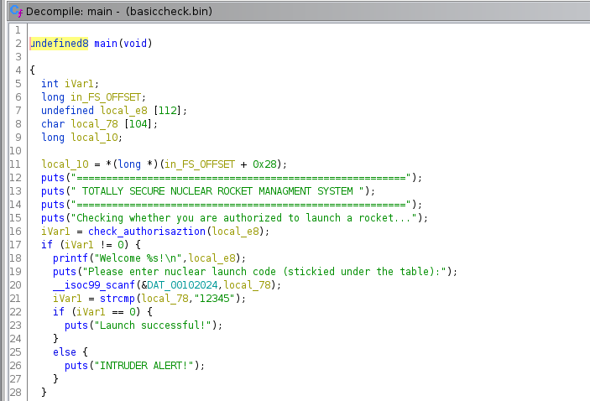
Exercise 1: Nuclear weaponry

Slide 29
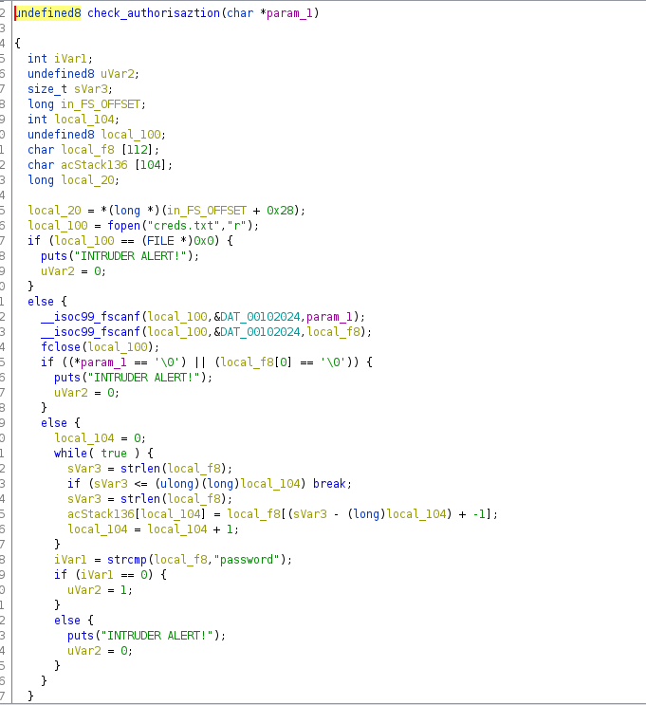

Slide 30
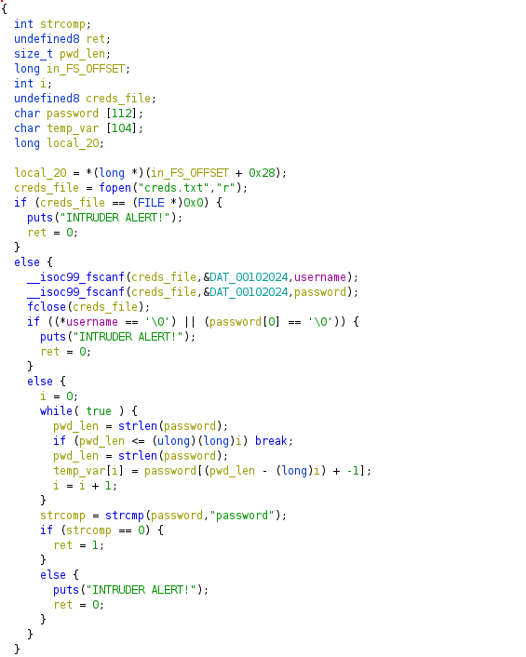

Slide 31
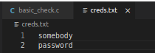
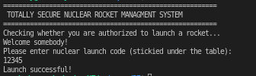

Slide 32
Exercise 2: Virtual bug remover
Somehow the VU got infested with bugs! Can you come evaporate them?
Time: 15 minutes
Files: debugger.bin

Slide 33
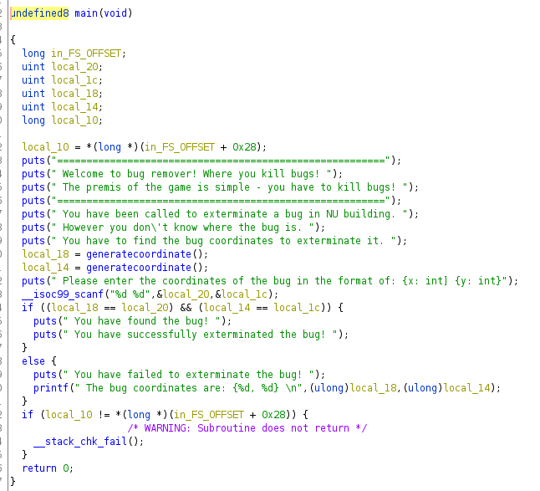

Slide 34
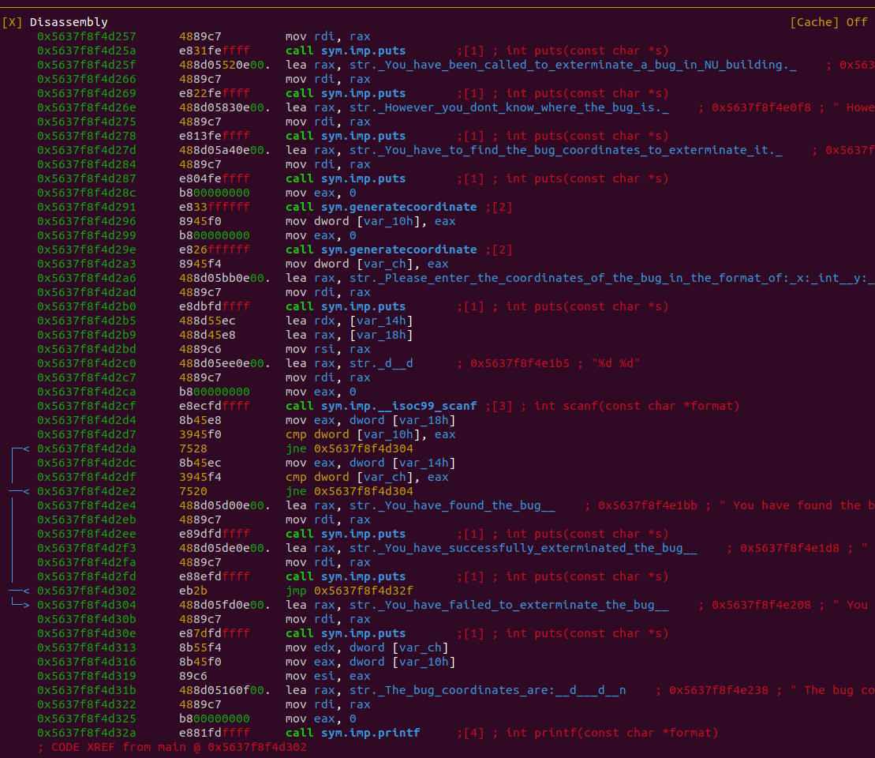
Commands used:
r2 -d debug.bin
aaa
dcu main
vv
dcu <eax calls>
dr eax
dc

Slide 35
Exercise 3: banking
VU wants to implement a banking system in order to enhance every day interaction within the uni. We managed to steal a prototype, can you break it so we can order unlimited coffee?
Time: 25 minutes
Files: banking.bin

Slide 36
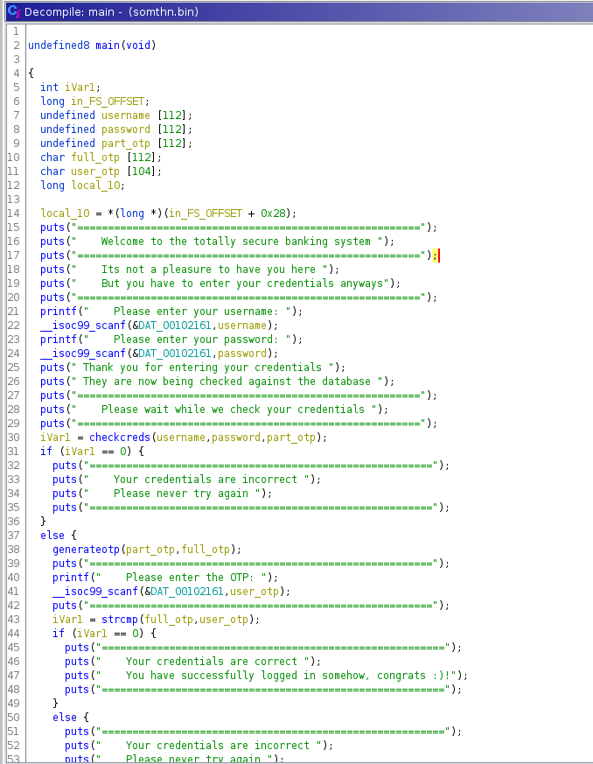
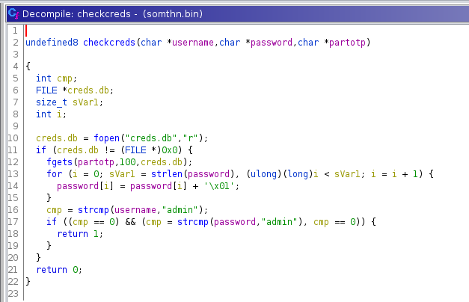
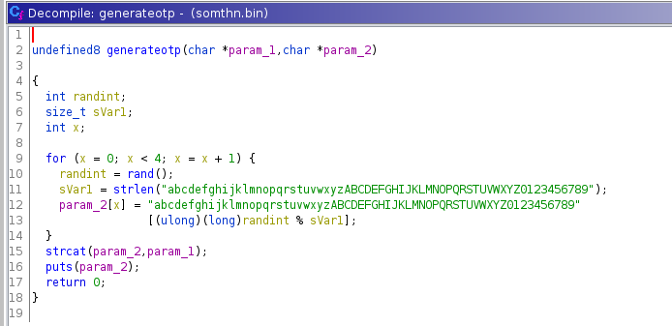

Slide 37
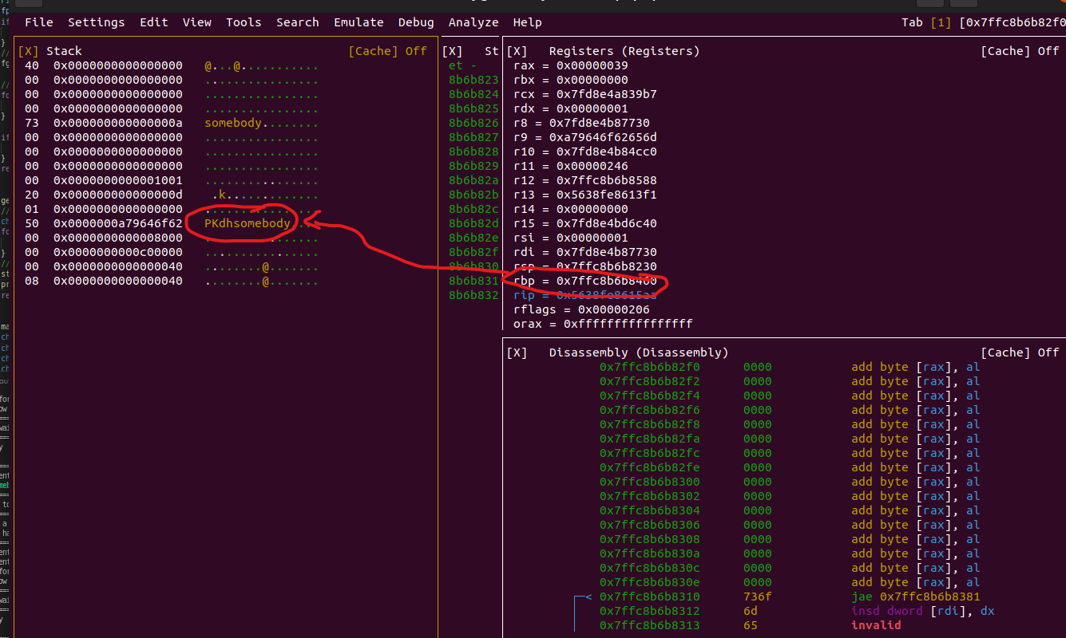
Commands used:
r2 -d debug.bin
aaa
dcu main
vv
dcu <otp calls>
dr rdb
(look at stack)
dc

Slide 38

Challenge for a beer
The following exercises are available for those who are still here, solve one and you get a beer for each!

Slide 39
Mazegen z Inc.
MazeGen Z sells their solutions online, can you generate your own?

Slide 40
Ransomewhere
Where did the virus run?

Slide 41

place of business software
Office but worse

Slide 42

Q&A
Have questions?
I’m surprised you are still here lol

Slide 43

GOOD LUCK
And good patience lol

Slide 44
Function prologue and epilogue
Syscalls:
rax: syscall number
rdi: arg0
rsi: arg1
rdx: arg2
r10-r8-r9: arg3-arg5
Function calls:
rax: return value
rdi: arg0
rsi: arg1
rdx: arg2
rcx-r8-r9: arg3-arg5
Call <address>
Same as:
push rip+len(instruct)
Jmp <address>
Function prologue:
Push rbp
Mov rbp, rsp
Sub rsp, 0x20
Function epilogue
Leave
Combines:
Mov rsp, rbp
Pop rbp
Ret
Same as “pop rip”
Notes:
A register is a temporary storage area built into a CPU. ... The instruction register fetches instructions from the program counter (PC) and holds each instruction as it is executed by the processor.
rbp is the frame pointer on x86_64. In your generated code, it gets a snapshot of the stack pointer (rsp) so that when adjustments are made to rsp (i.e. reserving space for local variables or pushing values on to the stack), local variables and function parameters are still accessible from a constant offset from rbp.
rsp is the stack pointer, which points to the top of the current stack frame

Slide 45
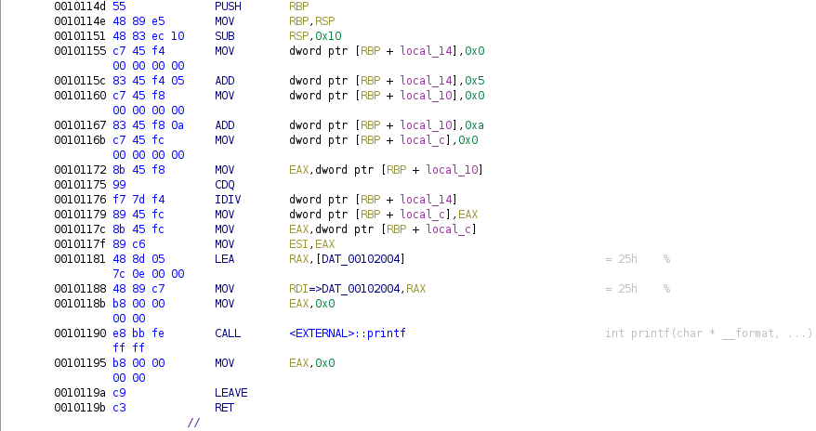
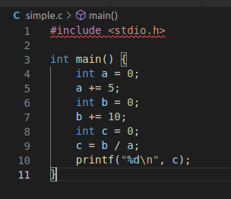
Notes:
The CDQ (Convert Doubleword to Quadword) instruction extends the sign bit of EAX into the EDX register.
The lea (load effective address) instruction is used to put a memory address into the destination.

Slide 46
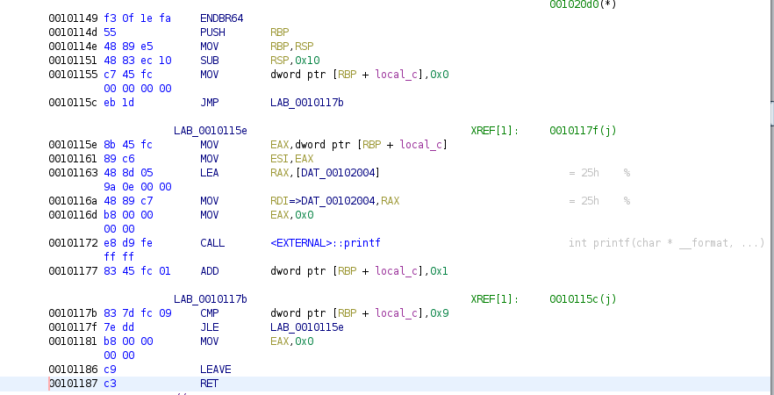
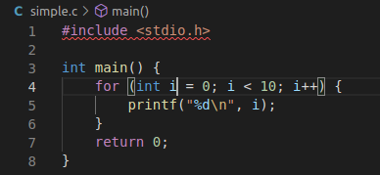
Notes:
The jle instruction is a conditional jump that follows a test.

Slide 47
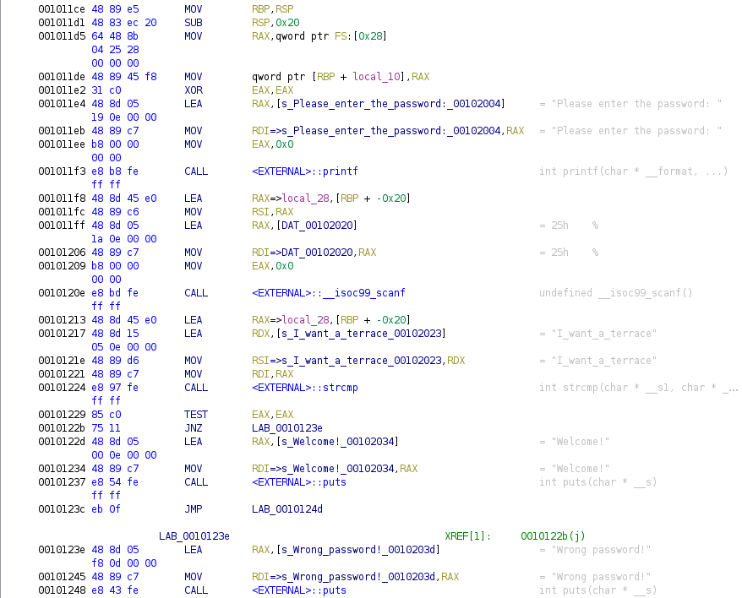

Slide 48
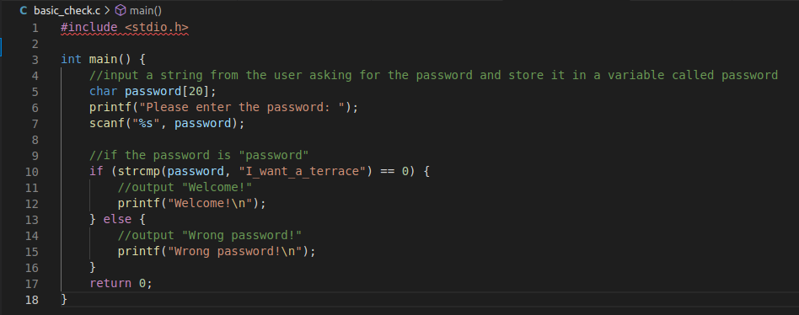
(totally secure code)

Slide 49
Radare 2
radare2. A free/libre toolchain for easing several low level tasks like forensics, software reverse engineering, exploiting, debugging, ... It is composed by a bunch of libraries (which are extended with plugins) and programs that can be automated with almost any programming language.

Slide 50
Essential commands
`aaa`, `s`, `px[wq]`, `ps`, `db`, `dc`, `dcr`, `ds`, `dr[r]`, `ood`, `dm`
Debugging:
Db <addr/sym> to set a breakpoint
`dc` to continue until hit
`ds` to step instructions into
`dso` the same but over calls
`dcr` continue till ret
Notes:
Aaa: deep analysis
S: print current address
Px: hexdumo
Drr:show register
Ood: reopen in debug mode
Dm; maps current address

